Slide 1

Welcome to amazon web services
Presented By :-
Mr. SURYADEV CHAUDHARY

Slide 2
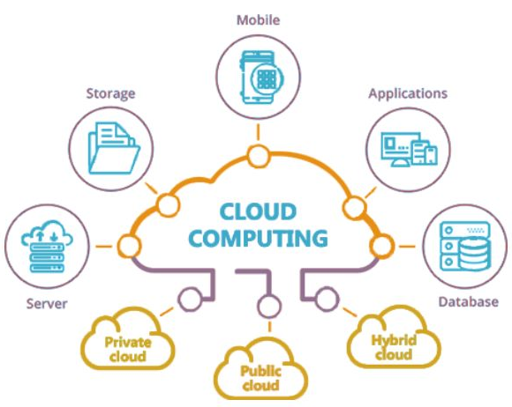
Cloud Computing

Slide 3
Content
What is Cloud?
Cloud consist of…
What is Cloud Computing?
Different Cloud Providers
History of Cloud Computing
Characteristics of Cloud Computing
Architecture of Cloud Computing
Models of Cloud Computing
Example of Cloud Computing
How Cloud Computing works?
Advantages of Cloud Computing
Disadvantages of Cloud Computing

Slide 4
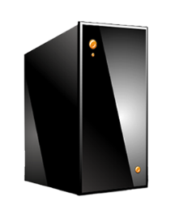

What is a Cloud?
The term CLOUD refers to a NETWORK or INTERNET.
In other words, we can say that CLOUD is something, which is present at remote location.
It’s a cluster!
It’s a supercomputer!
It’s a datastore!
Cloud = Lots of storage + compute
4

Slide 5
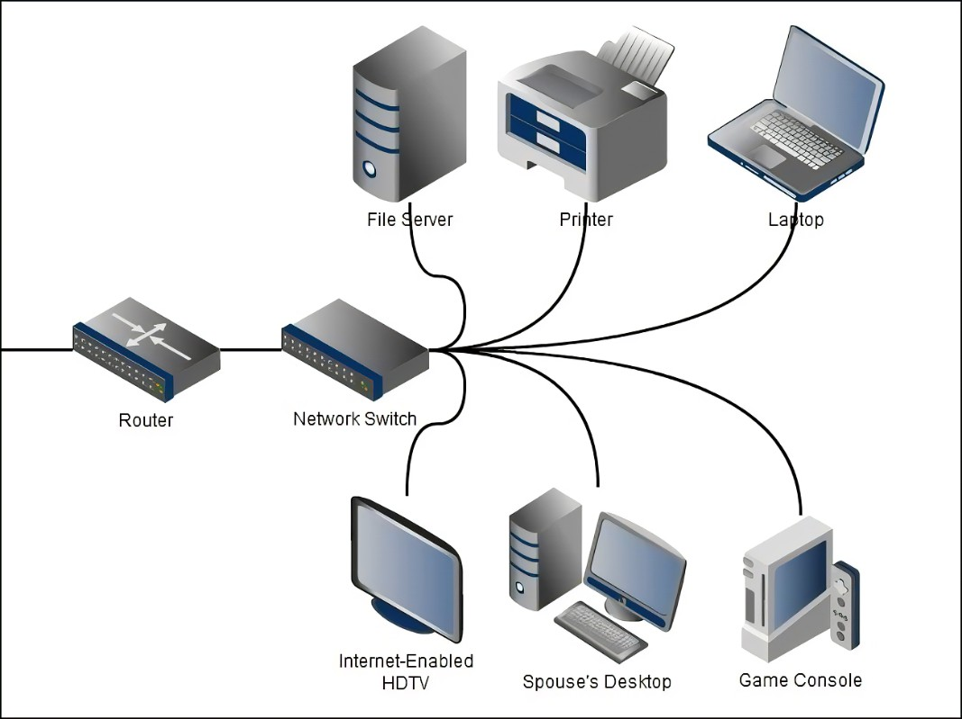
Cloud consist of…
A single-site cloud (“Datacenter”) consists of
Compute nodes
Networking Devices: Switches, Routers, etc.
A network topology, e.g., hierarchical
Software Services e.g, Gmail, MS office

Slide 6
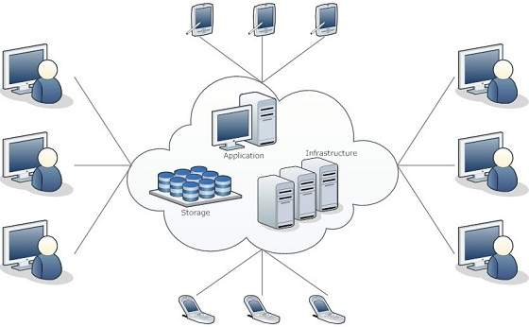
What is Cloud Computing?
Cloud Computing refers to storing manipulating, configuring, and accessing the hardware and software resources remotely.
The data can be anything such as files, images, documents, audio, video, and more.

Slide 7
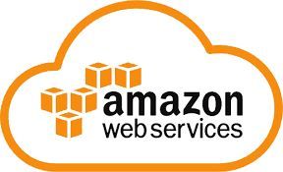
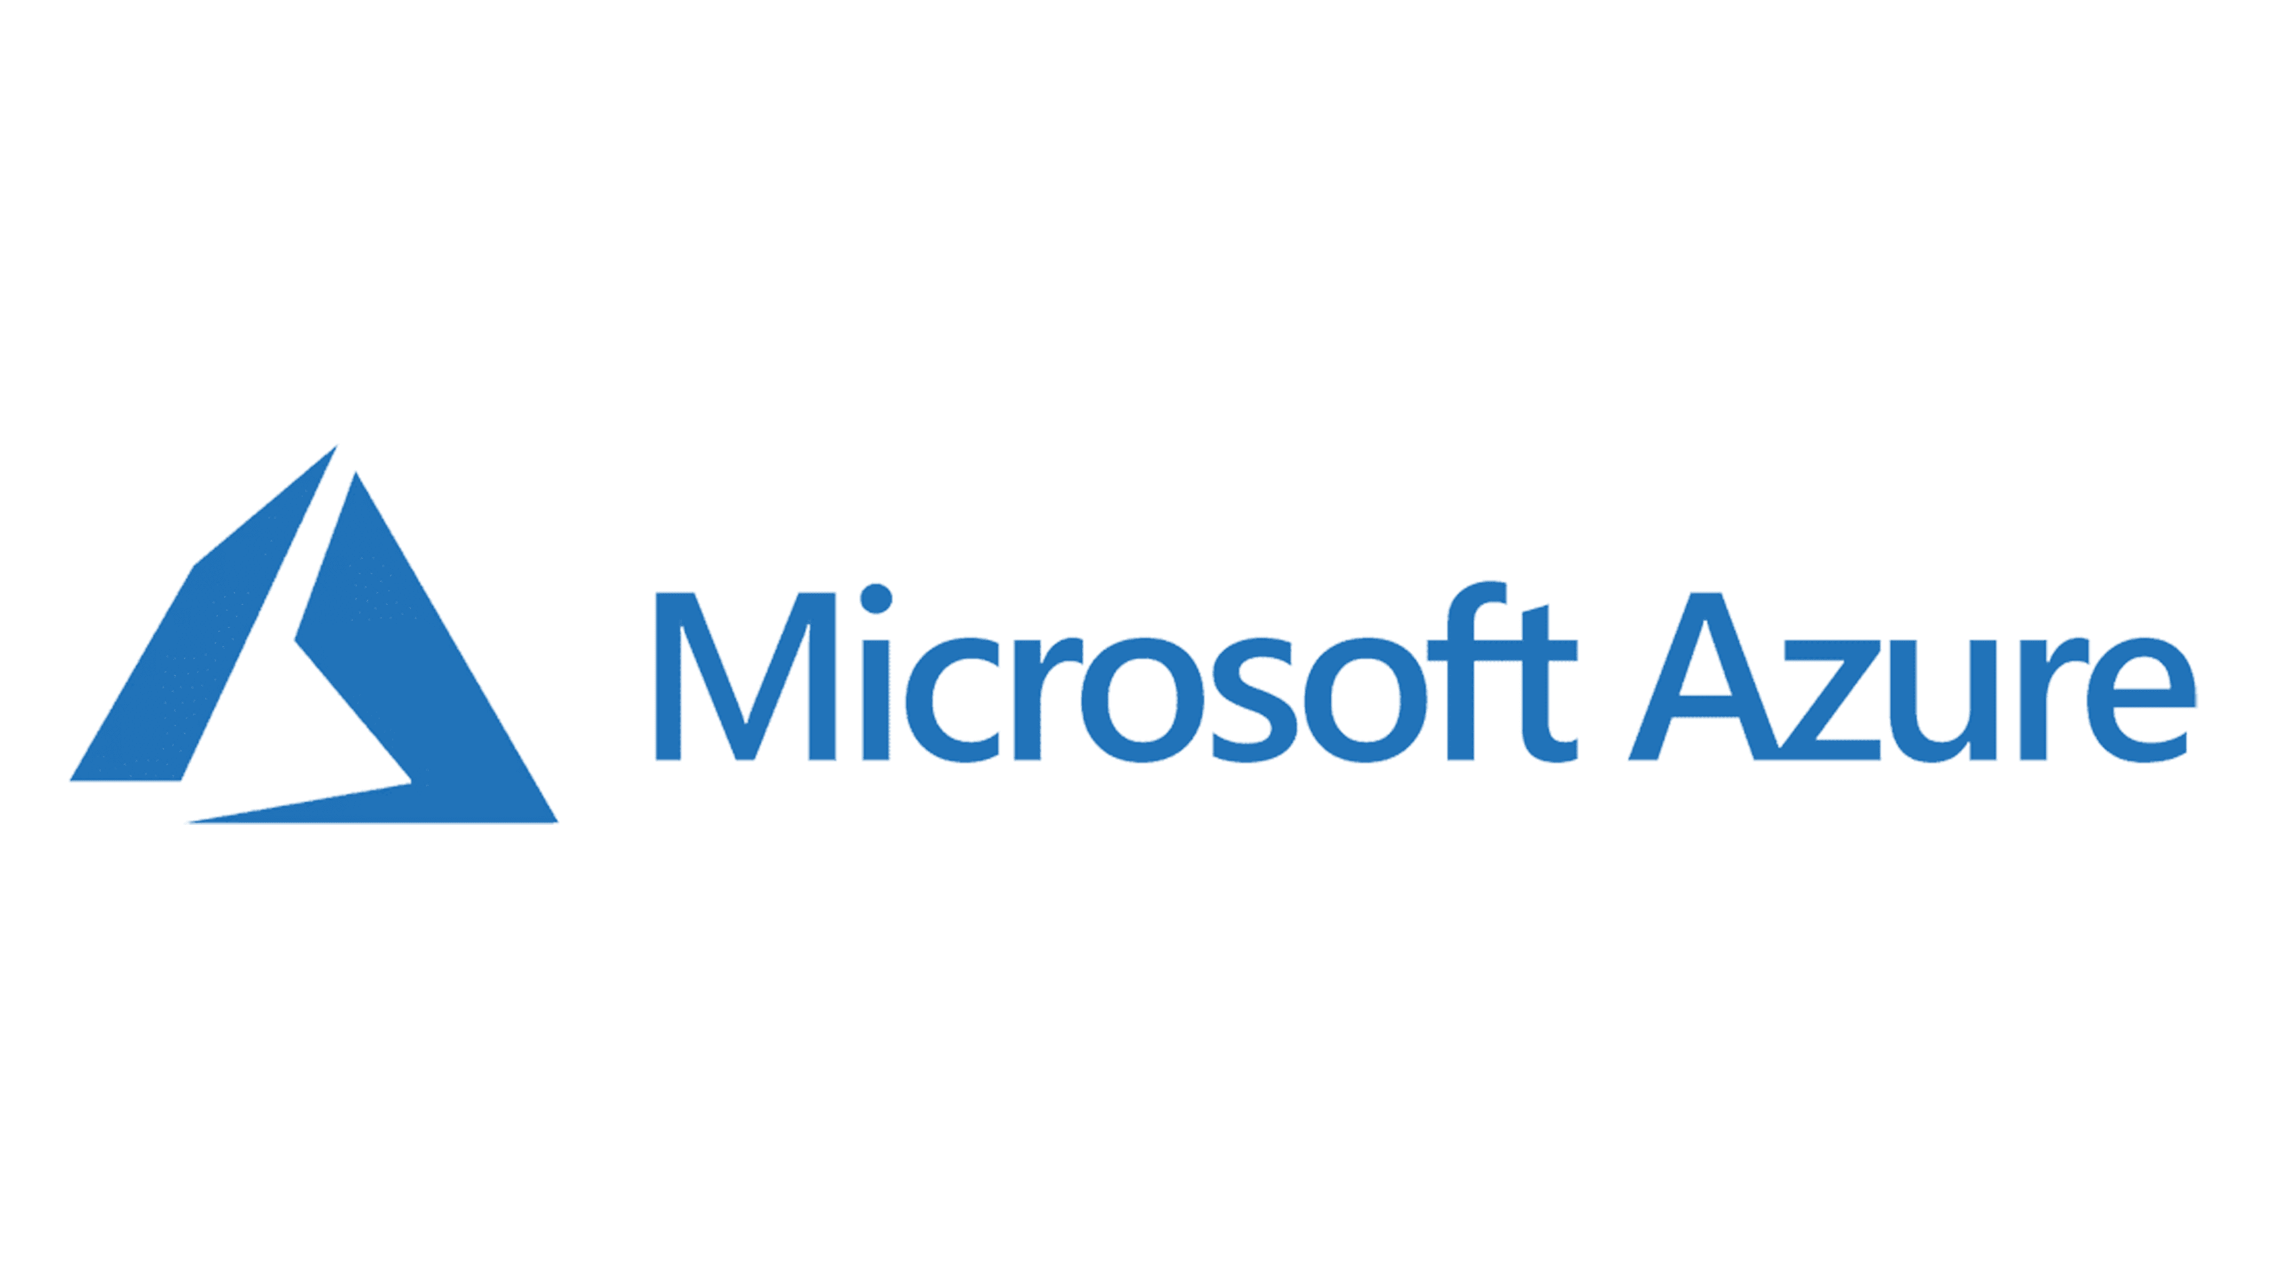
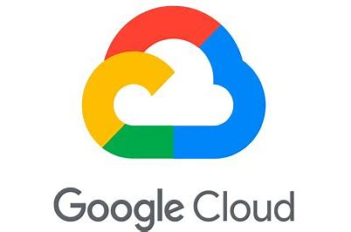
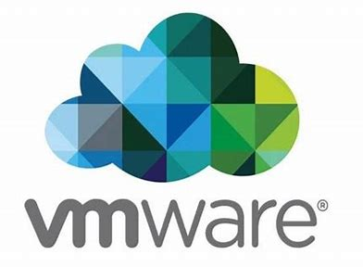
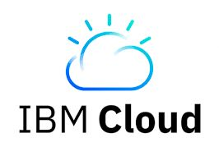
Top Cloud Providers
AWS: Amazon Web Services
Microsoft Azure
Google Cloud
IBM Cloud
VMWare

Slide 8
History of Cloud Computing
At around in 1961, John MacCharty suggested in a speech at MIT that computing can be sold like a utility, just like a water or electricity.
In 1999, Salesforce.com started delivering of applications to users using a simple website.
In 2002, Amazon started Amazon Web Services, providing services like storage, computation and even human intelligence.
In 2009, Google Apps also started to provide cloud computing enterprise applications
In 2009, Microsoft launched Windows Azure, and companies like Oracle and HP

Slide 9
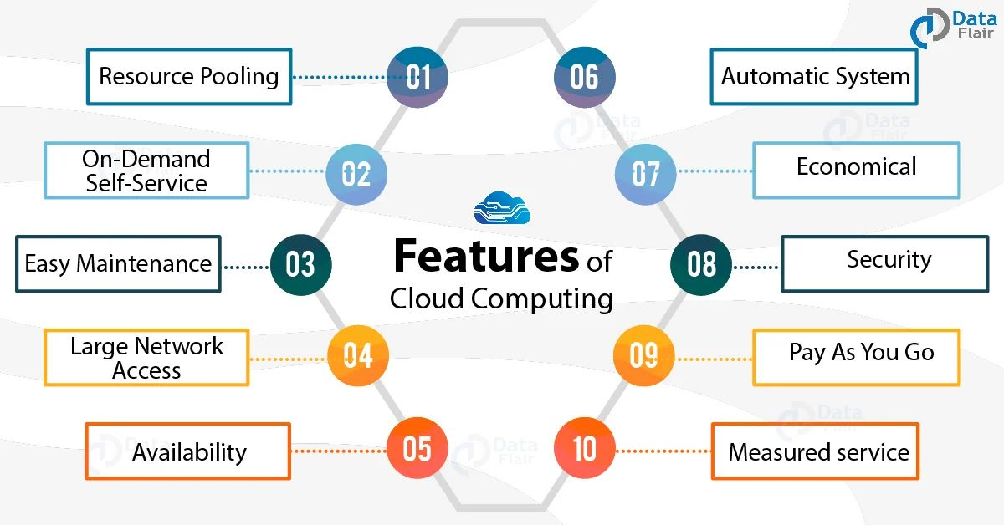
Characteristics of Cloud Computing
On-demand self service
Broad Network access
Resource Pooling
Rapid Elasticity
Measures services

Slide 10
Architecture of Cloud Computing It is divided into the following two parts -
Front End
Back End
The front end is used by the client.
It contains client-side interfaces that are required to access the cloud computing platforms.
The front end includes web servers (including Chrome, Firefox, internet explorer, etc.)
The back end is used by the service provider.
It manages all the resources that are required to provide cloud computing services.
It includes a huge amount of data storage, virtual machines, servers, traffic control mechanisms, etc.

Slide 11
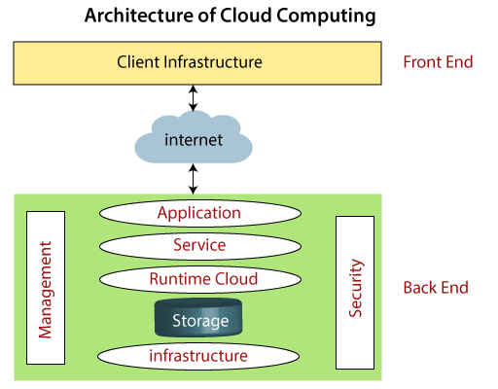

Slide 12
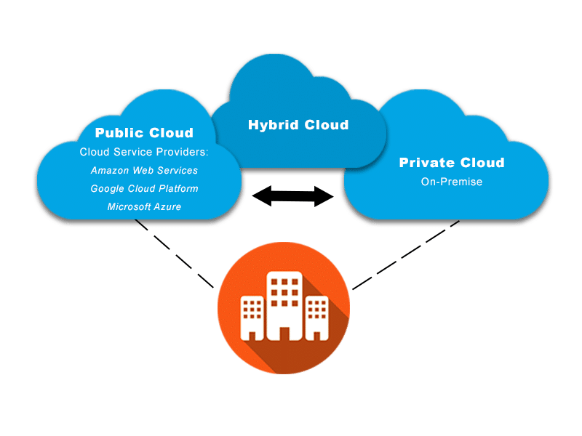
Models of Cloud Computing
Deployment Models
Service Models
1.Deployment Models
Public Cloud
Easily accessible to the general public
Private Cloud
Accessible within an organization
Hybrid Cloud
Public + Private= Hybrid
Community
Group of Organization

Slide 13
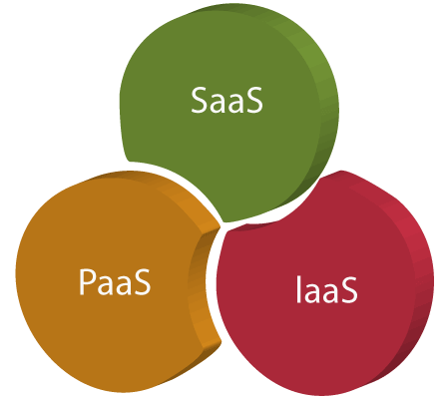
2.Service Models
Infrastructure as a Service(IAAS)
Network Architects
It helps users to avoid the cost and complexity of
purchasing and managing the physical servers.
Example: AWS, Azure, etc.
Platform as a Service(PAAS)
Application Developers
It is created for the programmer to develop, test, run
and manage the application.
Example: Heroku, Force. com, etc.
Software as a Service(SAAS)
End Users
It is hosted by the cloud service providers.
It also called as “on-demand Software”.
Example: Google apps, Dropbox, etc.

Slide 14
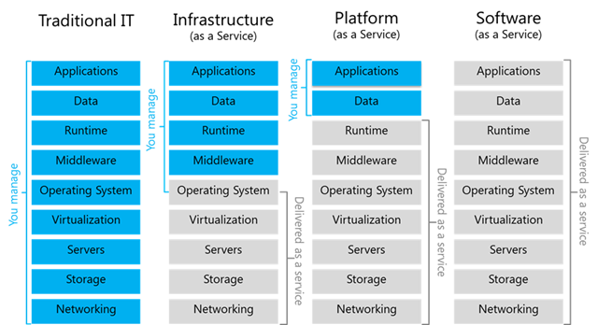
Diagram of IAAS, PAAS, SAAS

Slide 15
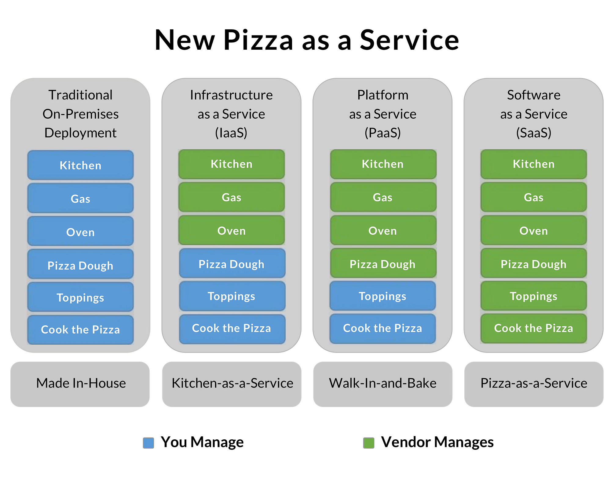

Slide 16

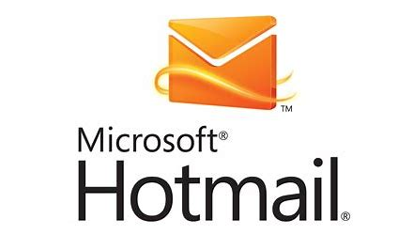
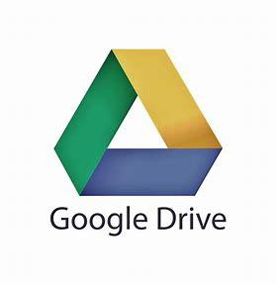
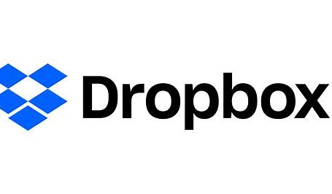
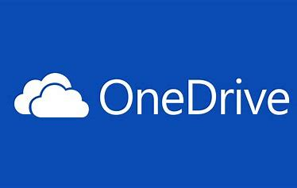
Example of Cloud Computing
Email: Web-based email services like Gmail and Hotmail deliver a cloud computing service
Storage: One Drive, Google Drive and Drop Box.

Slide 17
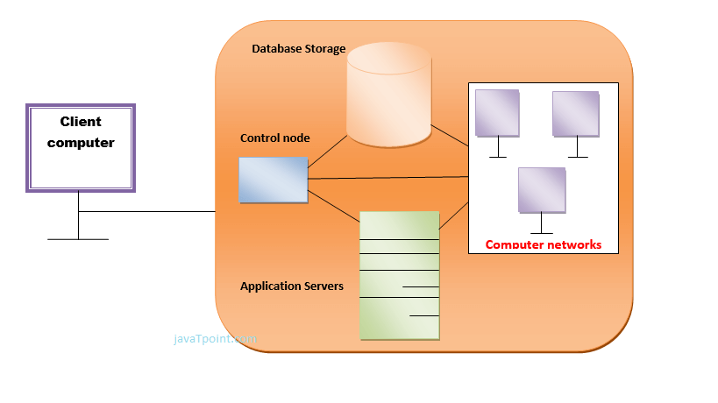
How Cloud Computing works?
A Cloud services platform such as Amazon Web Services owns and maintains the network-connected hardware required for these application services

Slide 18
Advantages of Cloud Computing
Increased Storage:- Service like S3,EFS Unlimited storage capacity (Massive scale) TBs, PBs and XBs.
Easy to Learn and Understand Cloud Applications like:- Gmail, Google Docs
Excellent Accessibility
Automatic Updating:- Saves Times and Efforts to Update
Low maintenance cost (Save time and save $$)
Pay as you go method (On-demand access with Customize Setting)
Data Security

Slide 19
Disadvantages of Cloud Computing
Internet Connection
Vendor lock-in (transferring services) also know as Migration Issue

Slide 20
The end
Thank You for Listening!

